Slide 1
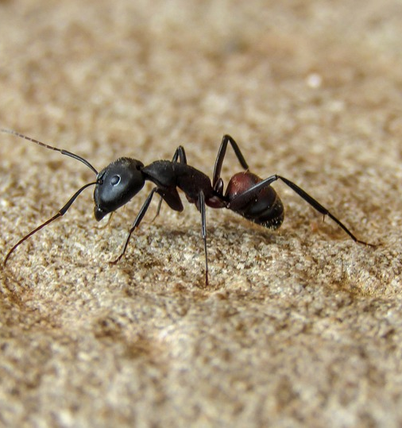

Back to home in desert
Overview
Paper of M. Collett
Concept of global and local vector
Conducted experiments
Model of the ant
Our simulation
Results

Slide 2
Paper of M. Collett
Written in 1998
Navigation of desert ants

Slide 3
Global and local vector
Problem: no visible landmarks
Solution: path integration
Sun as compass

Slide 4
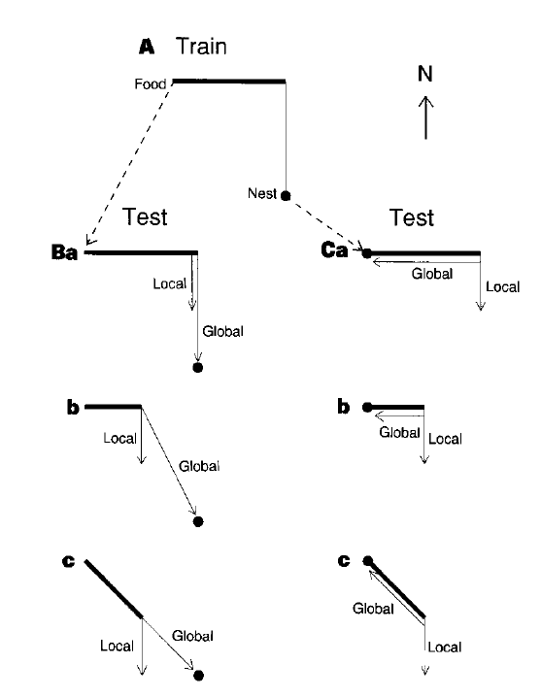
Conducted experiments
Ants get trained first
Ants picked up on way home

Slide 5
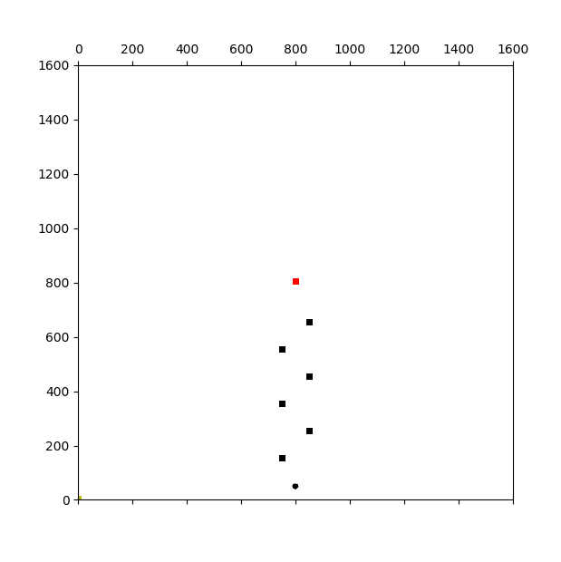
Conducted experiments II
Black cylinders als landmarks

